Slide 1
Chapter 9
Using Perl for CGI Programming
Programming the World Wide Web
Fourth edition
By Robert W. Sebesta

Slide 2
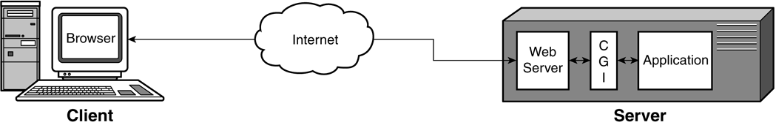
Figure 9.1 Communications and computation using CGI

Slide 3
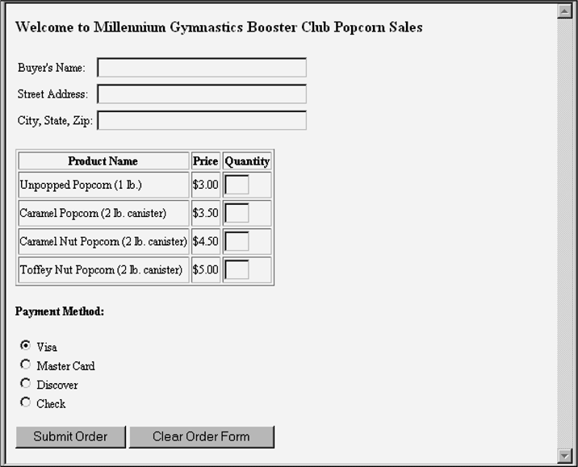
Figure 9.2 Display of popcorn.html

Slide 4
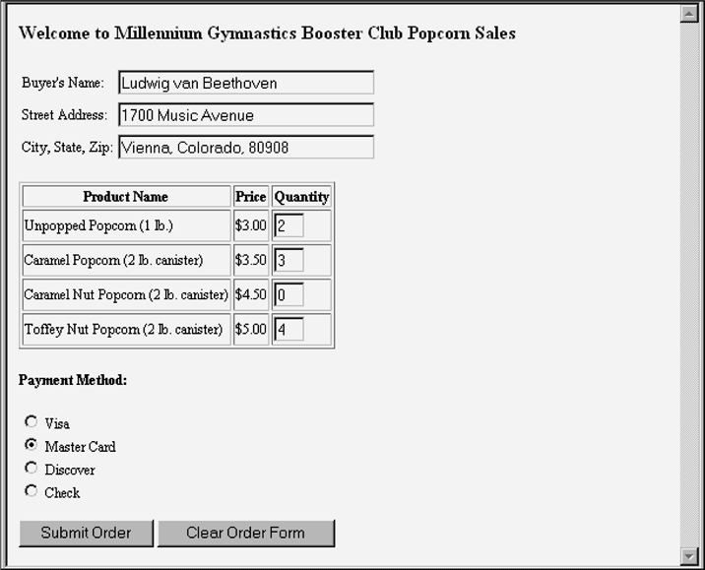
Figure 9.3 Display of popcorn.html after the form is filled out

Slide 5
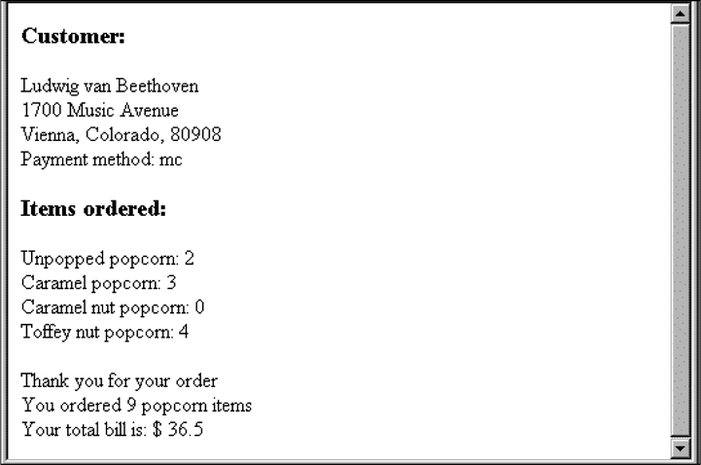
Figure 9.4 Output of popcorn.cgi

Slide 6
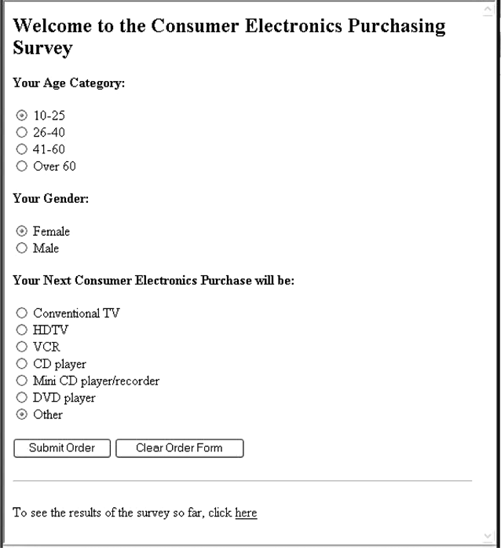
Figure 9.5 Display of conelec.html

Slide 7
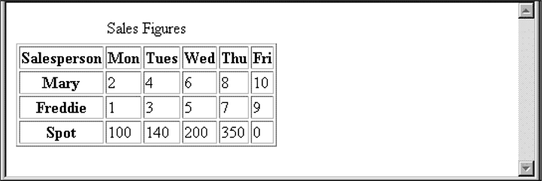
Figure 9.6 A table produced with table

Slide 8
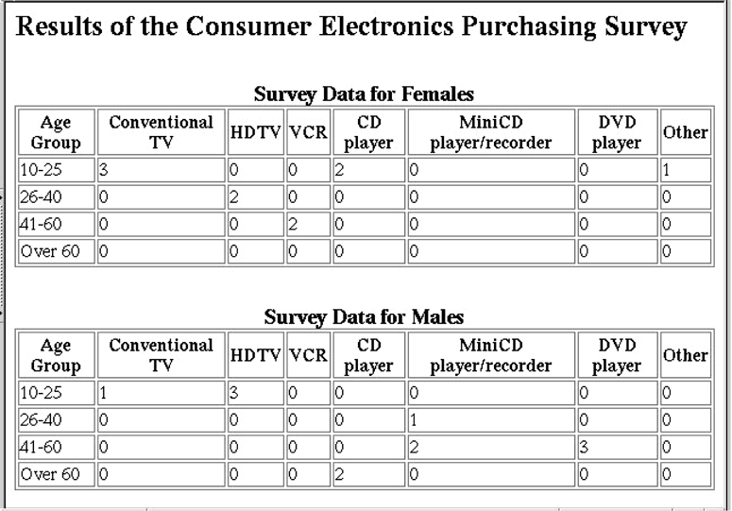
Figure 9.7 Survey results page

Slide 9

Figure 9.8 A document returned by day_cookie.pl

